Slide 1
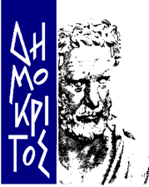


Optical Character Recognition for Handwritten Characters
National Center for Scientific Research “Demokritos” Athens - Greece
Institute of Informatics and Telecommunications
Computational Intelligence Laboratory (CIL)
Giorgos Vamvakas

Slide 2
Outline
Handwritten OCR systems
CIL - Greek Handwritten Character Database
Proposed OCR Methodology
Experimental Results
Experiments on Historical Documents
Future Work

Slide 3
OCR Systems
OCR systems consist of four major stages :
Pre-processing
Segmentation
Feature Extraction
Classification
Post-processing

Slide 4
Pre-processing
The raw data is subjected to a number of preliminary processing steps to make it usable in the descriptive stages of character analysis. Pre-processing aims to produce data that are easy for the OCR systems to operate accurately. The main objectives of pre-processing are :
Binarization
Noise reduction
Stroke width normalization
Skew correction
Slant removal

Slide 5
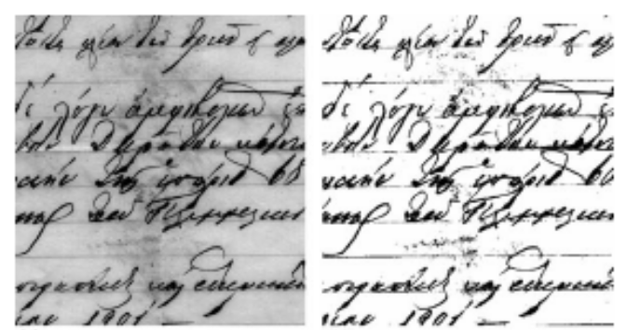
Binarization
Document image binarization (thresholding) refers to the conversion of a gray-scale image into a binary image. Two categories of thresholding:
Global, picks one threshold value for the entire document image which is often based on an estimation of the background level from the intensity histogram of the image.
Adaptive (local), uses different values for each pixel according to the local area information

Slide 6
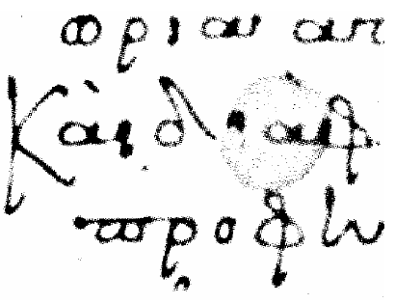
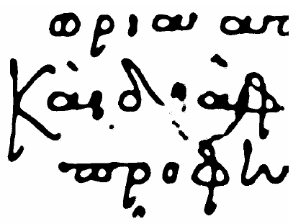

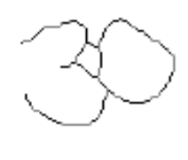
Noise Reduction - Normalization
Noise reduction improves the quality of the document. Two main approaches:
Filtering (masks)
Morphological Operations (erosion, dilation, etc)
Normalization provides a tremendous reduction in data size, thinning extracts the shape information of the characters.

Slide 7
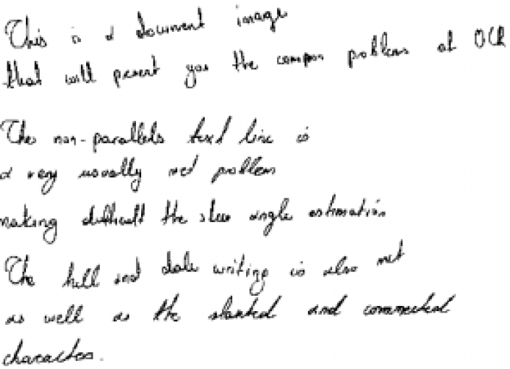
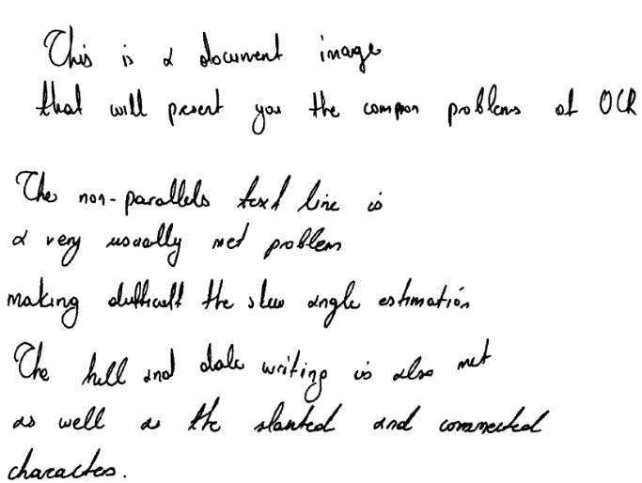
Skew Correction
Skew Correction methods are used to align the paper document with the coordinate system of the scanner. Main approaches for skew detection include correlation, projection profiles, Hough transform.

Slide 8





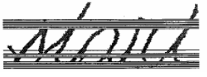
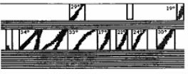
Slant Removal
The slant of handwritten texts varies from user to user. Slant removal methods are used to normalize the all characters to a standard form.
Popular deslanting techniques are:
Calculation of the average angle of near-vertical elements
Bozinovic – Shrihari Method (BSM).

Slide 9

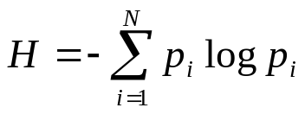



Slant Removal
Entropy
  The dominant slope of the character is found from the slope corrected characters which gives the minimum entropy of a vertical projection histogram. The vertical histogram projection is calculated for a range of angles ± R. In our case R=60, seems to cover all writing styles. The slope of the character, ,is found from:
  The character is then corrected by using:

Slide 10
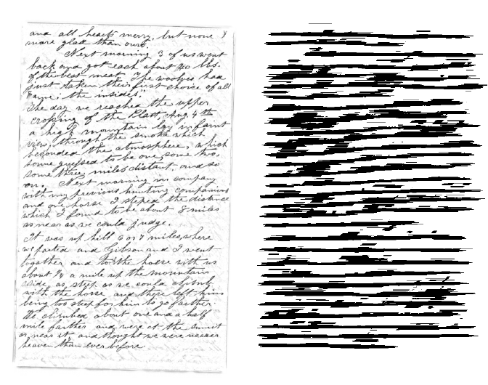
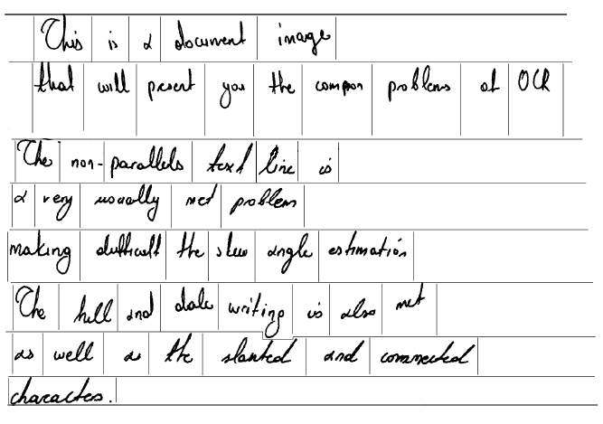

Segmentation
Text Line Detection (Hough Transform, projections, smearing)
Word Extraction (vertical projections, connected component analysis)
Word Extraction 2 (RLSA)

Slide 11
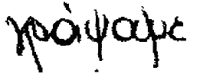
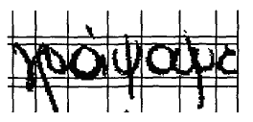
Segmentation
Explicit Segmentation
In explicit approaches one tries to identify the smallest possible word segments (primitive segments) that may be smaller than letters, but surely cannot be segmented further. Later in the recognition process these primitive segments are assembled into letters based on input from the character recognizer. The advantage of the first strategy is that it is robust and quite straightforward, but is not very flexible.
Implicit Segmentation
In implicit approaches the words are recognized entirely without segmenting them into letters. This is most effective and viable only when the set of possible words is small and known in advance, such as the recognition of bank checks and postal address

Slide 12
Feature Extraction
In feature extraction stage each character is represented as a feature vector, which becomes its identity. The major goal of feature extraction is to extract a set of features, which maximizes the recognition rate with the least amount of elements.
Due to the nature of handwriting with its high degree of variability and imprecision obtaining these features, is a difficult task. Feature extraction methods are based on 3 types of features:
Statistical
Structural
Global transformations and moments

Slide 13
Statistical Features
Representation of a character image by statistical distribution of points takes care of style variations to some extent.
The major statistical features used for character representation are:
Zoning
Projections and profiles
Crossings and distances

Slide 14

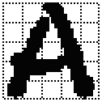
Zoning
The character image is divided into NxM zones. From each zone features are extracted to form the feature vector. The goal of zoning is to obtain the local characteristics instead of global characteristics

Slide 15

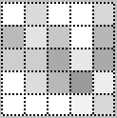
Zoning – Density Features
The number of foreground pixels, or the normalized number of foreground pixels, in each cell is considered a feature.
Darker squares indicate higher density of zone pixels.

Slide 16

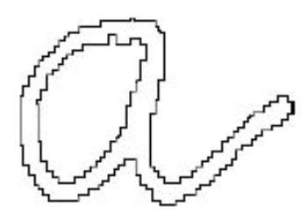
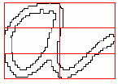
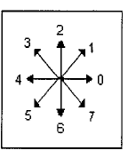
Zoning – Direction Features
Based on the contour of the character image
For each zone the contour is followed and a directional histogram is obtained by analyzing the adjacent pixels in a 3x3 neighborhood

Slide 17


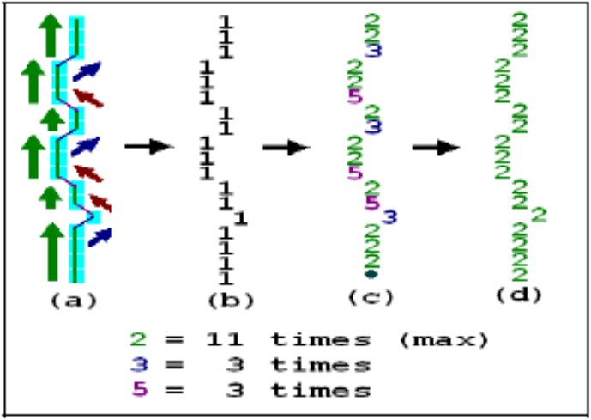
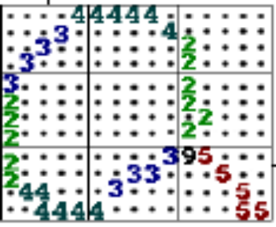

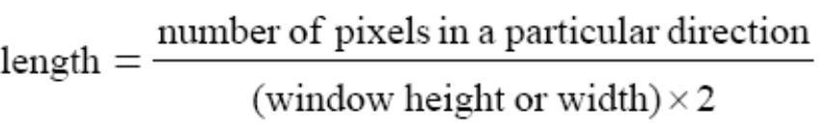
Zoning – Direction Features
Based on the skeleton of the character image
Distinguish individual line segments
Labeling line segment information
Line type normalization
Line segments are coded with a direction number
2 = vertical line segment
3 = right diagonal line segment
4 = horizontal line segment
5 = left diagonal line segment
Formation of feature vector through zoning
number of horizontal lines | total length of horizontal lines | number of right diagonal lines | total length of right diagonal lines | number of vertical lines | total length of vertical lines | number of left diagonal lines | total length of left diagonal lines | number of intersection points

Slide 18
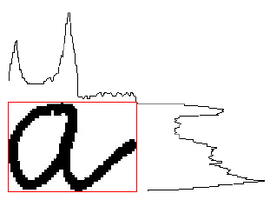
Projection Histograms
The basic idea behind using projections is that character images, which are 2-D signals, can be represented as 1-D signal. These features, although independent to noise and deformation, depend on rotation.
Projection histograms count the number of pixels in each column and row of a character image. Projection histograms can separate characters such as “m” and “n” .

Slide 19

Profiles
The profile counts the number of pixels (distance) between the bounding box of the character image and the edge of the character. The profiles describe well the external shapes of characters and allow to distinguish between a great number of letters, such as “p” and “q”.

Slide 20
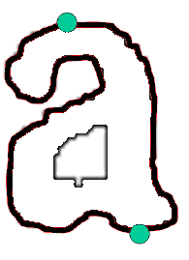
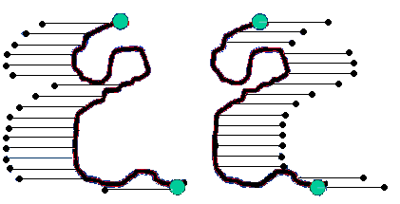
Profiles
Profiles can also be used to the contour of the character image
Extract the contour of the character
Locate the uppermost and the lowermost points of the contour
Calculate the in and out profiles of the contour

Slide 21
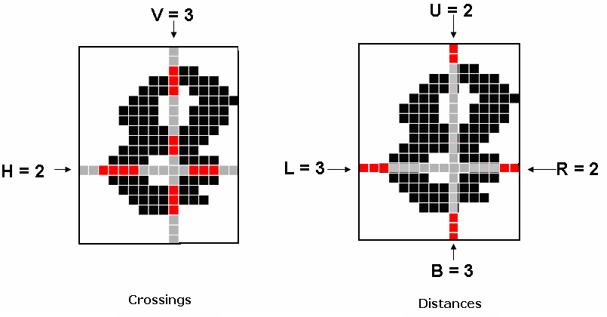
Crossings and Distances
Crossings count the number of transitions from background to foreground pixels along vertical and horizontal lines through the character image and Distances calculate the distances of the first image pixel detected from the upper and lower boundaries, of the image, along vertical lines and from the left and right boundaries along horizontal lines

Slide 22
Structural Features
Characters can be represented by structural features with high tolerance to distortions and style variations. This type of representation may also encode some knowledge about the structure of the object or may provide some knowledge as to what sort of components make up that object.
Structural features are based on topological and geometrical properties of the character, such as aspect ratio, cross points, loops, branch points, strokes and their directions, inflection between two points, horizontal curves at top or bottom, etc.

Slide 23
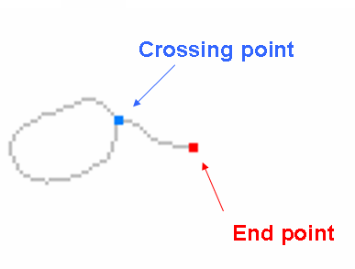
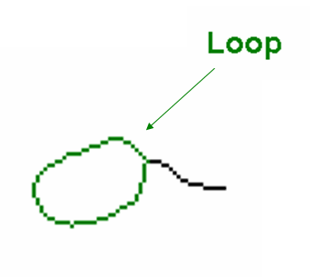
Structural Features

Slide 24
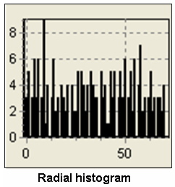
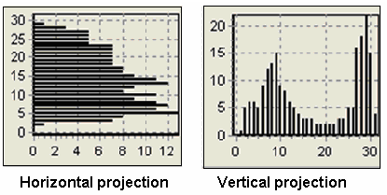
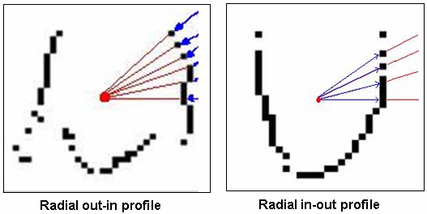
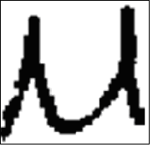
Structural Features
A structural feature extraction method for recognizing Greek handwritten characters [Kavallieratou et.al 2002]
Three types of features:
Horizontal and Vertical projection histograms
Radial histogram
Radial out-in and radial in-out profiles

Slide 25
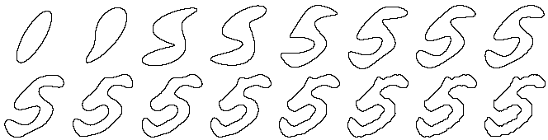
Global Transformations - Moments
The Fourier Transform (FT) of the contour of the image is calculated. Since the first n coefficients of the FT can be used in order to reconstruct the contour, then these n coefficients are considered to be a n-dimesional feature vector that represents the character.
Central, Zenrike moments that make the process of recognizing an object scale, translation, and rotation invariant. The original image can be completely reconstructed from the moment coefficients.

Slide 26
Classification
k-Nearest Neighbour (k-NN) , Bayes Classifier, Neural Networks (NN), Hidden Markov Models (HMM), Support Vector Machines (SVM), etc
There is no such thing as the “best classifier”. The use of classifier depends on many factors, such as available training set, number of free parameters etc.

Slide 27
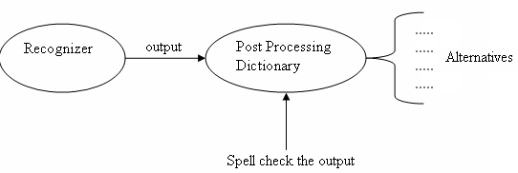
Post-processing
Goal : the incorporation of context and shape information in all the stages of OCR systems is necessary for meaningful improvements in recognition rates.
The simplest way of incorporating the context information is the utilization of a dictionary for correcting the minor mistakes.
In addition to the use of a dictionary, a well-developed lexicon and a set of orthographic rules (lexicon-driven matching approaches) during or after the recognition stage for verification and improvement purpose.
Drawback : Unrecoverable OCR decisions.

Slide 28
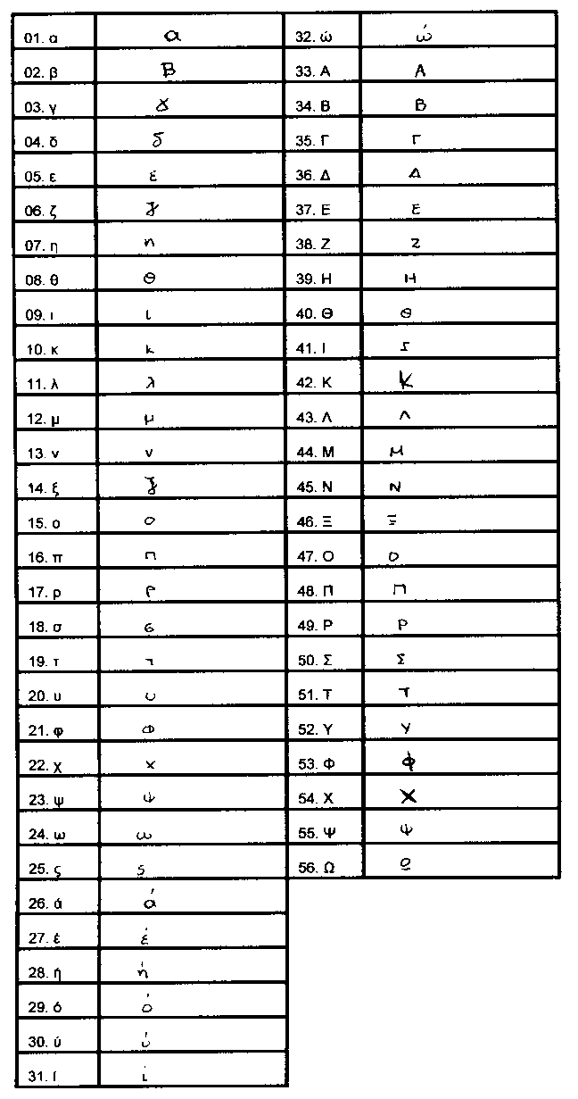
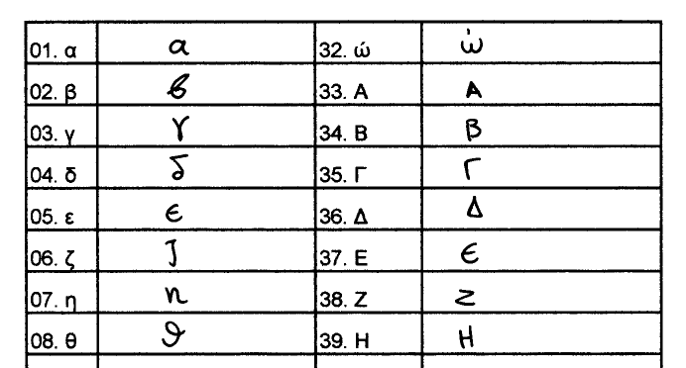

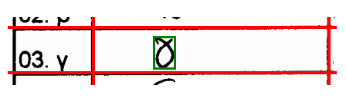
CIL- Greek Handwritten Character Database
Each form consists of 56 Greek handwritten characters:
    24 upper-case
    24 lower-case
    the final “ς”
    the accented vowels “ά”, “έ”, “ή”, “ί”, “ύ”, “ό”, “ώ”
The steps led to the Greek handwritten character database are:
    Line detection using Run Length Smoothing Algorithm (RLSA)
    Character extraction

Slide 29
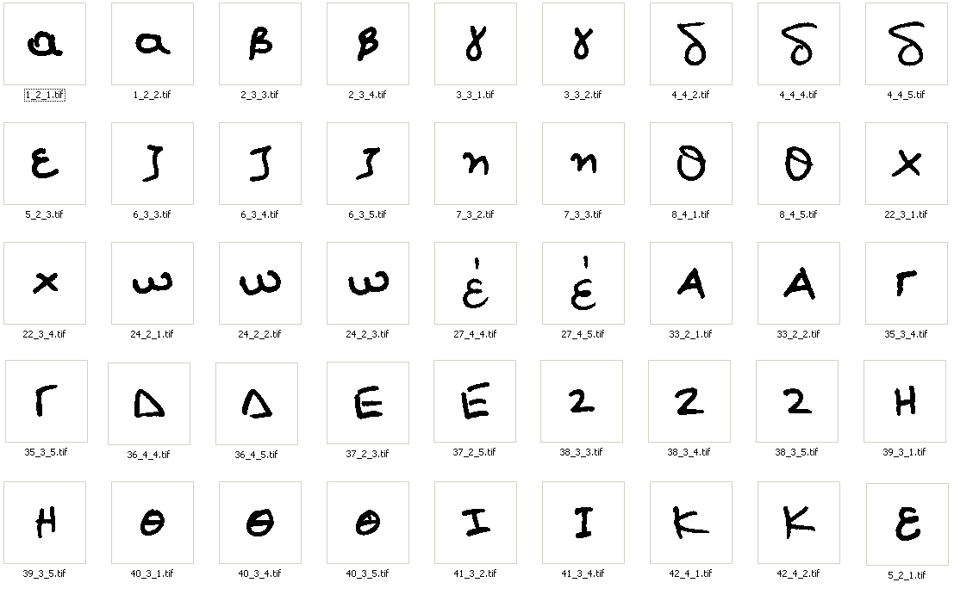
CIL- Greek Handwritten Character Database
CIL Database:
125 Greek writers
5 forms per writer
625 variations of each character led to an overall of 35,000 isolated and labeled Greek handwritten characters

Slide 30




Proposed OCR Methodology
Pre-processing :
Image size normalization
Slope correction
Feature Extraction

Slide 31
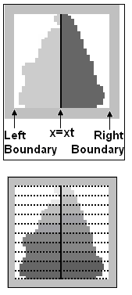
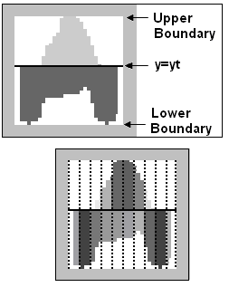
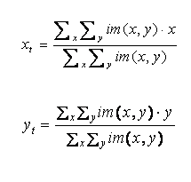
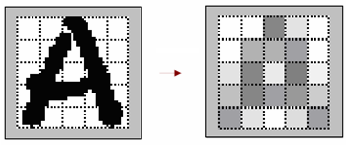


Feature Extraction
Two types of features :
Features based on zones:
    The character image is divided into horizontal and vertical zones and the density of character pixels is calculated for each zone
Features based on character projection profiles:
    The centre mass of the image is first found
    Upper/ lower profiles are computed by considering for each image column, the distance between the horizontal line and the closest pixel to the upper/lower boundary of the character image. This ends up in two zones depending on . Then both zones are divided into vertical blocks. For all blocks formed we calculate the area of the upper/lower character profiles.
    Similarly, we extract the features based on left/right profiles.

Slide 32
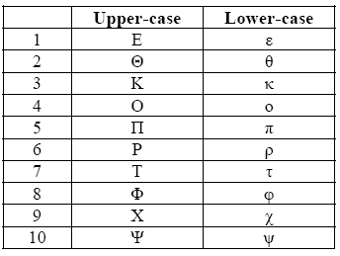
Experimental Results
The CIL Database was used
56 characters
625 variations of each character
35,000 isolated and labeled Greek handwritten characters
10 pairs of classes were merged, due to size normalization step, resulting to a database of 28,750 characters.

Slide 33
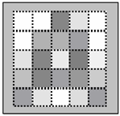
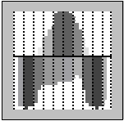
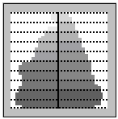
Experimental Results
1/5 of each class was used for testing and 4/5 for training
Character images normalized to a 60x60 matrix
Features
    Based on Zones
  5 horizontal and 5 vertical zones =>25 features
    Based on Upper and Lower profiles
  10 vertical zones => 20 features
    Based on Left and Right profiles
  10 horizontal zones => 20 features
    Total Number of features
    25 + 20 + 20 = 65

Slide 34
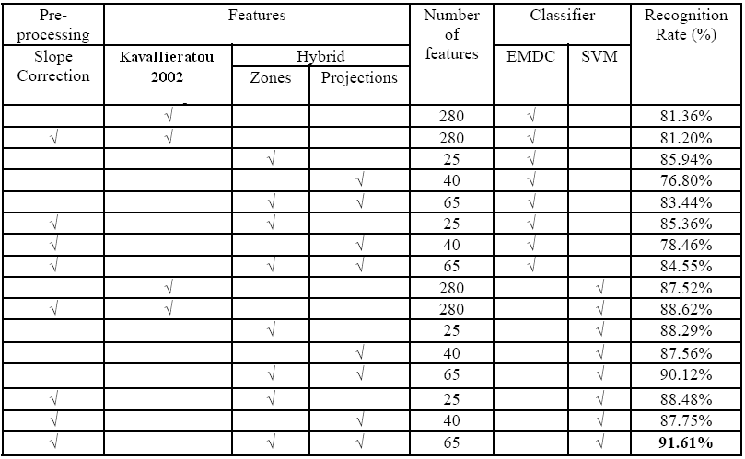
Experimental Results
The Greek handwritten character database was used:
Euclidean Minimum Distance Classifier (EMDC)
Support Vector Machines (SVM)

Slide 35
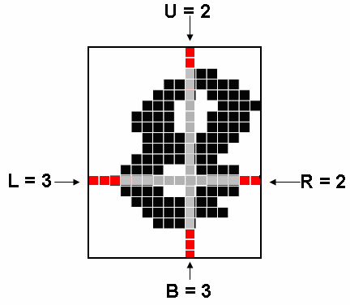
Experimental Results
Dimensionality Reduction
Three types of features
  our features
  325 features
  distance features
  profile features

Slide 36
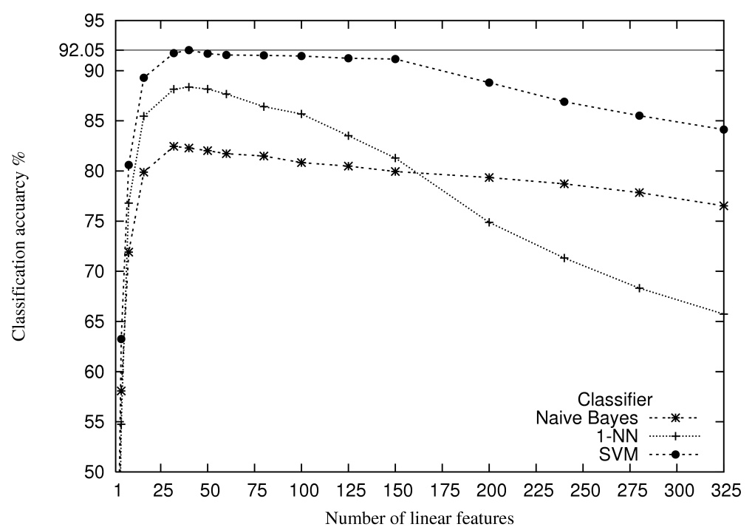
Experimental Results
Dimensionality Reduction
Linear Discriminant Analysis (LDA) method is employed, according to which the most significant linear features are those where the samples distribution has important overall variance while the samples per class distributions have small variance
Recognition Rate = 92.05%
Number of features = 40

Slide 37







Experiments on Historical Documents
12 Documents
11,963 “characters” using connected component labelling
Size normalization to a 60x60 matrix
e.g.
“Database” has 4,503 characters (lower-case Greek handwritten characters, that is “α”, “β”, “γ”, … ,“ω” and “ς”)
e.g.

Slide 38
Publications
G. Vamvakas, B. Gatos, I. Pratikakis, N. Stamatopoulos, A. Roniotis and S.J. Perantonis, "Hybrid Off-Line OCR for Isolated Handwritten Greek Characters", The Fourth IASTED International Conference on Signal Processing, Pattern Recognition, and Applications (SPPRA 2007), ISBN: 978-0-88986-646-1, pp. 197-202, Innsbruck, Austria, February 2007.
G. Vamvakas, N. Stamatopoulos ,B. Gatos, I. Pratikakis and S.J. Perantonis, "Standard Database and Methods for Handwritten Greek Character Recognition", accepted for publication in the proc. of the 11th Panhellenic Conference on Informatics (PCI 2007) ,Patras,May 2007.
“An Efficient Feature Extraction and Dimensionality Reduction Scheme for Isolated Greek Handwritten Character Recognition”, 9th International Conference on Document Analysis and Recognition (ICDAR 2007), Curitiba, Brazil, September 2007. Waiting...

Slide 39
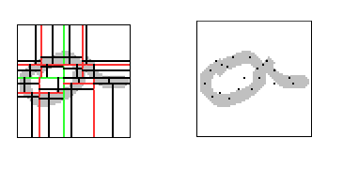
Future Work
Creating new hierarchical classification schemes based on rules after examining the corresponding confusion matrix.
Exploiting new features to improve the current performance.

